Slide 1
Linear and Integer Programming Models
Chapter 2

Slide 2
2.1 Introduction to Linear Programming
A Linear Programming model seeks to maximize or minimize a linear function, subject to a set of linear constraints.
The linear model consists of the following
components:
  A set of decision variables.
  An objective function.
  A set of constraints.

Slide 3
Introduction to Linear Programming
The Importance of Linear Programming
  Many real world problems lend themselves to linear
  programming modeling.
  Many real world problems can be approximated by linear models.
  There are well-known successful applications in:
    Manufacturing
    Marketing
    Finance (investment)
    Advertising
    Agriculture

Slide 4
Introduction to Linear Programming
The Importance of Linear Programming
  There are efficient solution techniques that solve linear programming models.
  The output generated from linear programming packages provides useful “what if” analysis.

Slide 5
Introduction to Linear Programming
Assumptions of the linear programming model
  The parameter values are known with certainty.
  The objective function and constraints exhibit constant returns to scale.
  There are no interactions between the decision variables (the additivity assumption).
  The Continuity assumption: Variables can take on any value within a given feasible range.

Slide 6
The Galaxy Industries Production Problem –
A Prototype Example
Galaxy manufactures two toy doll models:
  Space Ray.
  Zapper.
Resources are limited to
  1000 pounds of special plastic.
  40 hours of production time per week.

Slide 7
The Galaxy Industries Production Problem –
A Prototype Example
Marketing requirement
  Total production cannot exceed 700 dozens.
  Number of dozens of Space Rays cannot exceed number of dozens of Zappers by more than 350.
Technological input
  Space Rays requires 2 pounds of plastic and
  3 minutes of labor per dozen.
  Zappers requires 1 pound of plastic and
  4 minutes of labor per dozen.

Slide 8
The Galaxy Industries Production Problem –
A Prototype Example
The current production plan calls for:
  Producing as much as possible of the more profitable product, Space Ray ($8 profit per dozen).
  Use resources left over to produce Zappers ($5 profit
  per dozen), while remaining within the marketing guidelines.
The current production plan consists of:
Space Rays = 450 dozen
Zapper = 100 dozen
Profit = $4100 per week
8(450) + 5(100)

Slide 9
Management is seeking a production schedule that will increase the company’s profit.

Slide 10
A linear programming model
can provide an insight and an
intelligent solution to this problem.

Slide 11
The Galaxy Linear Programming Model
Decisions variables:
  X₁ = Weekly production level of Space Rays (in dozens)
  X₂ = Weekly production level of Zappers (in dozens).
Objective Function:
  Weekly profit, to be maximized

Slide 12
The Galaxy Linear Programming Model
Max 8X₁ + 5X₂ (Weekly profit)
subject to
2X₁ + 1X₂ ≤ 1000 (Plastic)
3X₁ + 4X₂ ≤ 2400 (Production Time)
X₁ + X₂ ≤ 700 (Total production)
X₁ - X₂ ≤ 350 (Mix)
X_{j}> = 0, j = 1,2 (Nonnegativity)

Slide 13
2.3 The Graphical Analysis of Linear Programming
The set of all points that satisfy all the constraints of the model is called
a
FEASIBLE REGION

Slide 14
Using a graphical presentation
we can represent all the constraints,
the objective function, and the three
types of feasible points.

Slide 15
Graphical Analysis – the Feasible Region
The non-negativity constraints
X₂
X₁

Slide 16
Graphical Analysis – the Feasible Region
X₂
1000
The Plastic constraint
2X₁+X₂ ≤ 1000
700
Total production constraint:
X₁+X₂ ≤ 700 (redundant)
500
Infeasible
Production
Time
3X₁+4X₂ ≤ 2400
Feasible
X₁
500
700

Slide 17
Graphical Analysis – the Feasible Region
X₂
1000
The Plastic constraint
2X₁+X₂ ≤ 1000
700
Total production constraint:
X₁+X₂ ≤ 700 (redundant)
500
Infeasible
Production mix
constraint:
X₁-X2 ≤ 350
Production
Time
3X₁+4X2≤ 2400
Feasible
500
700
X₁
  Interior points.
  Boundary points.
Extreme points.
There are three types of feasible points

Slide 18

Solving Graphically for an Optimal Solution

Slide 19
The search for an optimal solution
X₂
Start at some arbitrary profit, say profit = $2,000...
1000
Then increase the profit, if possible...
...and continue until it becomes infeasible
700
Profit =$4360
500
X₁
500

Slide 20
Summary of the optimal solution
  Space Rays = 320 dozen
  Zappers = 360 dozen
  Profit = $4360
  This solution utilizes all the plastic and all the production hours.
  Total production is only 680 (not 700).
  Space Rays production exceeds Zappers production by only 40 dozens.

Slide 21
Extreme points and optimal solutions
  If a linear programming problem has an optimal solution, an extreme point is optimal.

Slide 22
Multiple optimal solutions
For multiple optimal solutions to exist, the objective function must be parallel to one of the constraints
Any weighted average of optimal solutions is also an optimal solution.

Slide 23
2.4 The Role of Sensitivity Analysis of the Optimal Solution
Is the optimal solution sensitive to changes in input parameters?
Possible reasons for asking this question:
  Parameter values used were only best estimates.
  Dynamic environment may cause changes.
  “What-if” analysis may provide economical and operational information.

Slide 24
Sensitivity Analysis of
Objective Function Coefficients.
Range of Optimality
  The optimal solution will remain unchanged as long as
    An objective function coefficient lies within its range of optimality
    There are no changes in any other input parameters.
  The value of the objective function will change if the
  coefficient multiplies a variable whose value is nonzero.

Slide 25
Sensitivity Analysis of
Objective Function Coefficients.
1000
X₂
Max 4X₁ + 5X₂
Max 3.75X₁ + 5X₂
Max 8X₁ + 5X₂
500
Max 2X₁ + 5X₂
X₁
500
800

Slide 26
Sensitivity Analysis of
Objective Function Coefficients.
1000
X₂
Max8X₁ + 5X₂
Range of optimality: [3.75, 10]
500
Max 10 X₁ + 5X₂
Max 3.75X₁ + 5X₂
400
600
800
X₁

Slide 27
Reduced cost
  Assuming there are no other changes to the input parameters, the reduced cost for a variable X_{j} that has a value of “0” at the optimal solution is:
  The negative of the objective coefficient increase of the variable X_{j} (-ΔC_{j}) necessary for the variable to be positive in the optimal solution
  Alternatively, it is the change in the objective value per unit increase of X_{j}.
Complementary slackness
  At the optimal solution, either the value of a variable is zero, or its reduced cost is 0.

Slide 28
Sensitivity Analysis of
Right-Hand Side Values
In sensitivity analysis of right-hand sides of constraints we are interested in the following questions:
  Keeping all other factors the same, how much would the optimal value of the objective function (for example, the profit) change if the right-hand side of a constraint changed by one unit?
  For how many additional or fewer units will this per unit change be valid?

Slide 29
Sensitivity Analysis of
Right-Hand Side Values
Any change to the right hand side of a binding constraint will change the optimal solution.
Any change to the right-hand side of a non-binding constraint that is less than its slack or surplus, will cause no change in the optimal solution.

Slide 30
Shadow Prices
Assuming there are no other changes to the input parameters, the change to the objective function value per unit increase to a right hand side of a constraint is called the “Shadow Price”

Slide 31
Shadow Price – graphical demonstration
The Plastic
constraint
X₂
When more plastic becomes available (the plastic constraint is relaxed), the right hand side of the plastic constraint increases.
1000
Maximum profit = $4360
2X₁ + 1x₂ <=1001
2X₁ + 1x₂ <=1000
Maximum profit = $4363.4
500
Shadow price =
4363.40 – 4360.00 = 3.40
Production time
constraint
X₁
500

Slide 32
Range of Feasibility
Assuming there are no other changes to the input parameters, the range of feasibility is
  The range of values for a right hand side of a constraint, in which the shadow prices for the constraints remain unchanged.
  In the range of feasibility the objective function value changes as follows:
  Change in objective value =
  [Shadow price][Change in the right hand side value]

Slide 33
Range of Feasibility
The Plastic
constraint
X₂
Increasing the amount of plastic is only effective until a new constraint becomes active.
1000
2X₁ + 1x₂ <=1000
Production mix
constraint
X₁ + X₂ ≤ 700
A new active
constraint
500
This is an infeasible solution
Production time
constraint
X₁
500

Slide 34
Range of Feasibility
The Plastic
constraint
X₂
Note how the profit increases as the amount of plastic increases.
1000
2X₁ + 1x₂ ≤1000
500
Production time
constraint
X₁
500

Slide 35
Range of Feasibility
X₂
Less plastic becomes available (the plastic constraint is more restrictive).
1000
Infeasible
solution
The profit decreases
500
2X₁ + 1X₂ ≤ 1100
A new active
constraint
X₁
500

Slide 36
The correct interpretation of shadow prices
  Sunk costs: The shadow price is the value of an extra unit of the resource, since the cost of the resource is not included in the calculation of the objective function coefficient.
  Included costs: The shadow price is the premium value above the existing unit value for the resource, since the cost of the resource is included in the calculation of the objective function coefficient.

Slide 37
Other Post - Optimality Changes
Addition of a constraint.
Deletion of a constraint.
Addition of a variable.
Deletion of a variable.
Changes in the left - hand side coefficients.

Slide 38
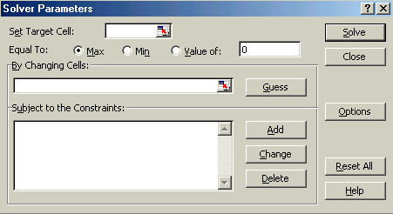
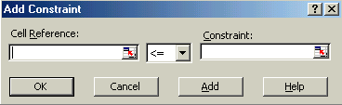
2.5 Using Excel Solver to Find an Optimal Solution and Analyze Results
To see the input screen in Excel click Galaxy.xls
Click Solver to obtain the following dialog box.
This cell contains
the value of the
objective function
Set Target cell
$D$6
Equal To:
By Changing cells
These cells contain
the decision variables
$B$4:$C$4
To enter constraints click…
All the constraints
have the same direction,
thus are included in
one “Excel constraint”.
$D$7:$D$10 $F$7:$F$10

Slide 39
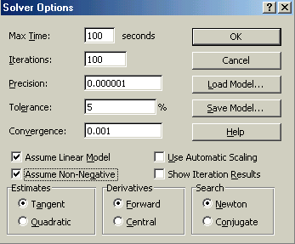
Using Excel Solver
To see the input screen in Excel click Galaxy.xls
Click Solver to obtain the following dialog box.
This cell contains
the value of the
objective function
Set Target cell
$D$6
Equal To:
By Changing cells
These cells contain
the decision variables
$B$4:$C$4
$D$7:$D$10<=$F$7:$F$10
Click on ‘Options’
and check ‘Linear
Programming’ and
‘Non-negative’.

Slide 40
Using Excel Solver
To see the input screen in Excel click Galaxy.xls
Click Solver to obtain the following dialog box.
Set Target cell
$D$6
Equal To:
By Changing cells
$B$4:$C$4
$D$7:$D$10<=$F$7:$F$10

Slide 41
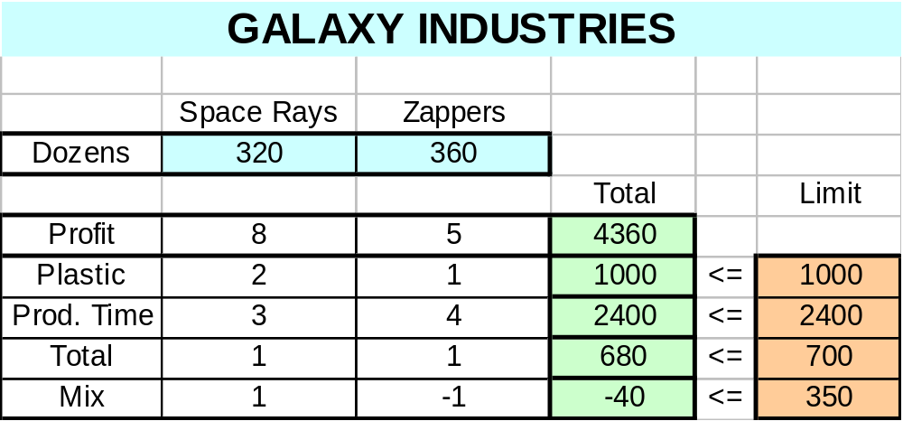
Using Excel Solver – Optimal Solution

Slide 42
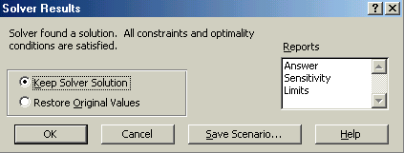
Using Excel Solver – Optimal Solution
Solver is ready to provide
reports to analyze the
optimal solution.

Slide 43
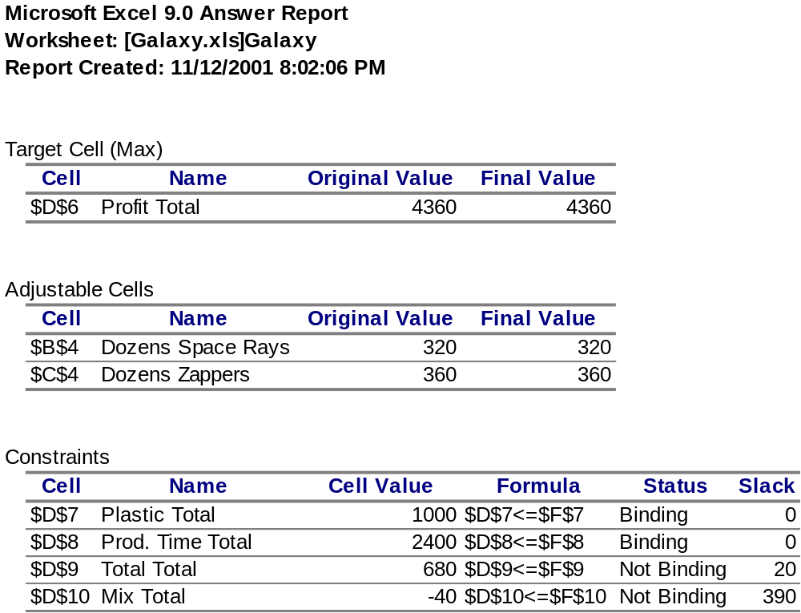
Using Excel Solver –Answer Report

Slide 44
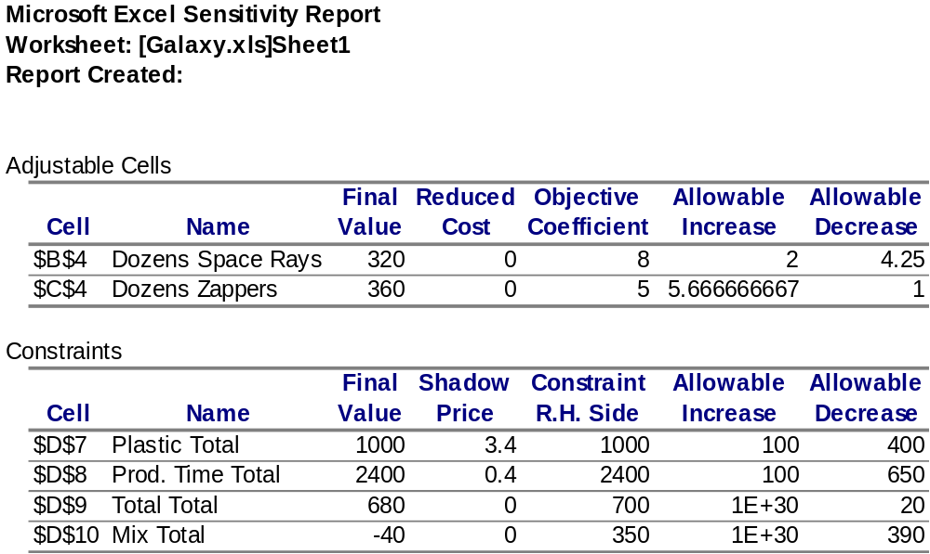
Using Excel Solver –Sensitivity Report

Slide 45
2.7 Models Without Unique Optimal Solutions
Infeasibility: Occurs when a model has no feasible point.
Unboundness: Occurs when the objective can become infinitely large (max), or infinitely small (min).
Alternate solution: Occurs when more than one point optimizes the objective function

Slide 46
Infeasible Model
No point, simultaneously,
lies both above line and
below lines and
.
1
2
3
2
3
1

Slide 47
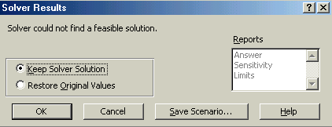
Solver – Infeasible Model

Slide 48


Unbounded solution
Maximize
the Objective Function
The feasible region

Slide 49
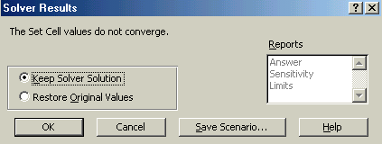
Solver – Unbounded solution

Slide 50
Solver – An Alternate Optimal Solution
Solver does not alert the user to the existence of alternate optimal solutions.
Many times alternate optimal solutions exist when the allowable increase or allowable decrease is equal to zero.
In these cases, we can find alternate optimal solutions using Solver by the following procedure:

Slide 51
Solver – An Alternate Optimal Solution
Observe that for some variable X_{j} the
Allowable increase = 0, or
Allowable decrease = 0.
Add a constraint of the form:
Objective function = Current optimal value.
If Allowable increase = 0, change the objective to Maximize X_{j}
If Allowable decrease = 0, change the objective to Minimize X_{j}

Slide 52
2.8 Cost Minimization Diet Problem
Mix two sea ration products: Texfoods, Calration.
Minimize the total cost of the mix.
Meet the minimum requirements of Vitamin A,
Vitamin D, and Iron.

Slide 53
Cost Minimization Diet Problem
Decision variables
  X1 (X2) -- The number of two-ounce portions of Texfoods (Calration) product used in a serving.
The Model
  Minimize 0.60X1 + 0.50X2
  Subject to
  20X1 + 50X2 ≥ 100 Vitamin A
  25X1 + 25X2 ≥ 100 Vitamin D
  50X1 + 10X2 ≥ 100 Iron
  X1, X2 ≥ 0
Cost per 2 oz.
% Vitamin A
provided per 2 oz.
% required

Slide 54
The Diet Problem - Graphical solution
10
The Iron constraint
Feasible Region
Vitamin “D” constraint
Vitamin “A” constraint
2
4
5

Slide 55
Cost Minimization Diet Problem
Summary of the optimal solution
  Texfood product = 1.5 portions (= 3 ounces)
  Calration product = 2.5 portions (= 5 ounces)
  Cost =$ 2.15 per serving.
  The minimum requirement for Vitamin D and iron are met with no surplus.
  The mixture provides 155% of the requirement for Vitamin A.

Slide 56
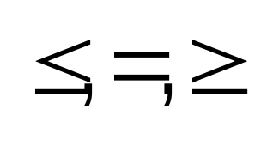
Computer Solution of Linear Programs With Any Number of Decision Variables
Linear programming software packages solve large linear models.
Most of the software packages use the algebraic technique called the Simplex algorithm.
The input to any package includes:
  The objective function criterion (Max or Min).
  The type of each constraint: .
  The actual coefficients for the problem.

Slide 57
Copyright © 2002 John Wiley & Sons, Inc. All rights reserved. Reproduction or translation of this work beyond that named in Section 117 of the United States Copyright Act without the express written consent of the copyright owner is unlawful. Requests for further information should be addressed to the Permissions Department, John Wiley & Sons, Inc. Adopters of the textbook are granted permission to make back-up copies for their own use only, to make copies for distribution to students of the course the textbook is used in, and to modify this material to best suit their instructional needs. Under no circumstances can copies be made for resale. The Publisher assumes no responsibility for errors, omissions, or damages, caused by the use of these programs or from the use of the information contained herein.

